Slide 1
THESIS & DISSERTATION PROCESS OVERVIEW
This presentation will be recorded.
Fall 2025 | Cratis D. Williams School of Graduate Studies
Presented by Wesley Kapp, Publications & Special Projects Coordinator

Slide 2
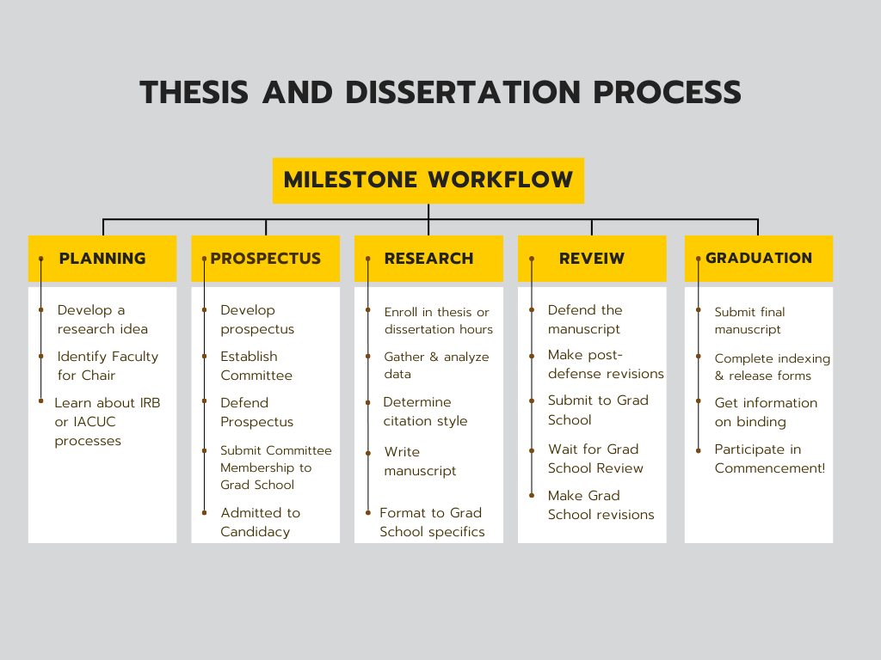
Thesis and Dissertation Process Milestone Workflow
Please note that the Milestone Workflow may vary depending on whether you are doing a thesis or dissertation.

Slide 3
Responsibilities
Your Responsibilities
Chair’s Responsibilities
Creating a high-quality and publishable manuscript
Finishing in a timely manner
Communicating with your Committee throughout the process
Mentoring you throughout the process
Scheduling the defense and sharing the date with the community
Submitting the final draft to the Graduate School

Slide 4
Committee Selection
Committee Chair - start thinking about and talking to professors about this early on in your program. Your committee chair should have full graduate faculty status (talk to your program direct if you aren’t sure about this).
Committee member selection - talk to your Chair about who might be a good fit. Other students, faculty, and program directors may have good recommendations as well. Start with who you know and go from there!
Please wait to fill out a special course form for thesis/dissertation hours until AFTER your committee form has been approved by the Graduate School.

Slide 5
Thesis Committee Formation
Once you’re committee is selected and you’ve met the requirements for candidacy, your committee chair should submit the thesis committee form. You can only sign up for thesis hours after this form has been approved.
The Graduate School no longer requires thesis students to submit their prospectus or IRB information/attestation when they submit their committee forms. However, these requirements should still be met and handled at the program level.

Slide 6
Dissertation Committee Formation
If you are doctorate student doing a dissertation, you must submit your dissertation committee form, your prospectus/proposal, and IRB information or attestation to the Graduate School at the same time.
You can only sign up for dissertation hours after you have submitted these materials and your committee form has been approved by the Graduate School.

Slide 7
Preparing to Write
Determine your style guide or journal requirements (APA, MLA, Chicago, etc.)
Know your deadlines!
Research protections (human subjects, animals, biosafety, responsible conduct, intellectual property, export controls, conflict of interest)
Review the Thesis/Dissertation Handbook & download the formatting template.
Track AI usage for the AI disclosure statement.
Use the formatting template and pre-set Styles for accessibility (it’s much easier to write your paper in the template or copy and paste to ensure formatting requirements are met)

Slide 8
Research Protections at App State
The Office of Research and Innovation provides “ethical and regulatory oversight of research involving human participants, animals, and recombinant DNA.”
Start the process early (IRB staff recommend starting 3-5 months in advance of data collection). Ideally, work on the application and your prospectus simultaneously. You should turn in IRB information with your prospectus.
IRB Full Review Process (human subjects)
List your Committee Chair as the Principle Investigator (PI).
check out the Student Corner for FAQ & more.

Slide 9
Research & Writing Support
Research Advisory Program (RAP) appointment with the library
Research Funding - apply for a GSGA Award or funding with the Office of Student Research
Writing Center appointments (or check out their website for style guide information, grammar tips, etc.)
Appointment with the Graduate School Publications & Special Projects Coordinator - email thesis@appstate.edu
Resources from GSL (Grad Student Writing Group every Thursday, workshops)

Slide 10
Formatting
Use the formatting templates provided in the Thesis & Dissertation Handbook
Please do include the signature page (without signatures)
List the month you graduate (August, December, or May), not the defense date
Use Styles feature in Word to make formatting easier (see How to use the updated templates video [YouTube])
add alt text for figures (provide alt text or re-type content instead of using screenshots)
obtain copyright permissions for figures adapted from other sources
export using “Save as” to properly export heading styles, alt text, etc.

Slide 11
Finalizing
Match your citations against your reference/bibliography—you shouldn’t have any sources listed in your reference list that aren’t cited in your paper and vice versa
Check that headers are nested properly
Check your pagination against the template (pay close attention to the front matter)
Check for consistent labels for figures and tables
Follow all of your style guide/journal guidelines
Ensure all copyright attributions are included and permissions records are maintained

Slide 12
Finalizing continued
Check the Tips for a Quick Review sheet for more
Attend the Formatting Workshop or watch the most recent recording posted on the Grad School Workshops webpage
Check out the library’s information on Creative Common Licenses and consider the best option for you. While your manuscript will be available on Open AIR, you have the option to select full copyright or a Creative Commons License.

Slide 13
Final Timeline
Submit a copy of your manuscript to the committee at least 8 weeks before Commencement (roughly)
Hold your defense at least 6 weeks before Commencement (Fall – 11/7; Spring – 3/27; Summer – 6/19)
Post-defense, make any final changes suggested by your committee. Obtain signatures on the Open AIR ETD Release Form and submit a copy of the signed form and your finalized manuscript to thesis@appstate.edu. Fall – 11/21; Spring – 4/10; Summer – 7/6
Complete any recommended edits by The Graduate School and submit your final document by the deadline*: Fall – 12/11; Spring – 5/6; Summer – 7/31
try to turn in your manuscript early as you may be required to complete a second (or third) round of small edits

Slide 14
Questions? Want more?
Email thesis@appstate.edu with any follow up questions or to set up an appointment.
Join the Grad Student Write In on Thursdays 9-11am in 204H Belk Library, next to the Writing Center. Register on Engage or drop in.
Check the Graduate School Events page for more workshops and professional development opportunities.
Attend the next Thesis/Dissertation Formatting Workshop – October 23, 6–7pm, Zoom. Register on Engage, or if you can’t make it, watch the recording of the September session posted on the Workshop page.

